Slide 1
Generative AI

Slide 2
What you will learn?
Generative AI?
Large Language Models (LLMs)
OpenAI
Langchain
Vector Database
Llama Index
Open Source LLM model
End to End Project

Slide 3
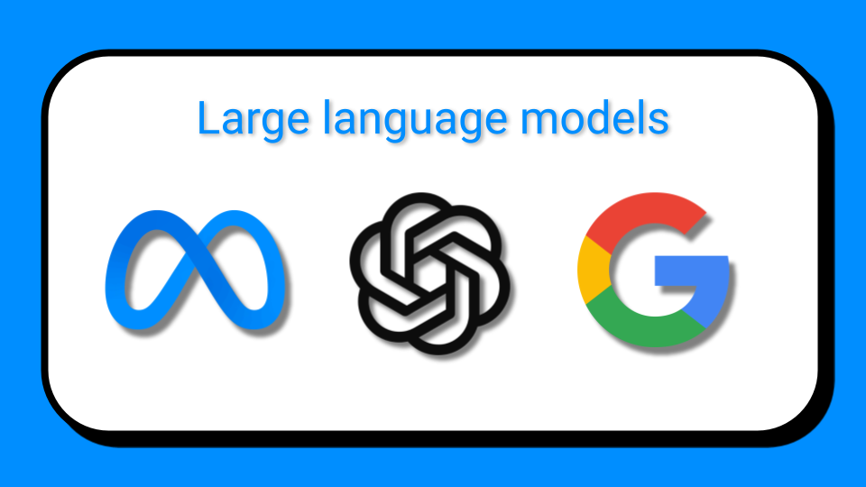
Generative AI
ChatGPT
Google Bard
Meta Llama 2

Slide 4
What is Generative AI?
Generative AI generate new data based on training sample.Generative model can generate Image,Text, Audio, Videos etc. data as output.
So generative AI is a very huge topics,
Generative Image model
Generative Language model

Slide 5

Generative Model:
Questions
Responses

Slide 6
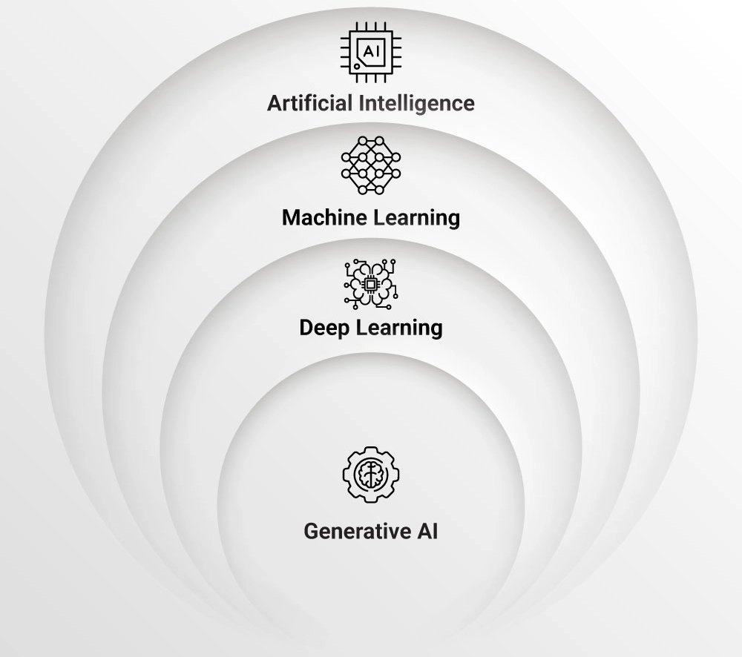
Where Generative AI Exists.
Machine Learning is the subset of Artificial Intelligence
Deep Learning is the subset of Machine Learning
Generative AI is the subset of Deep Learning

Slide 7
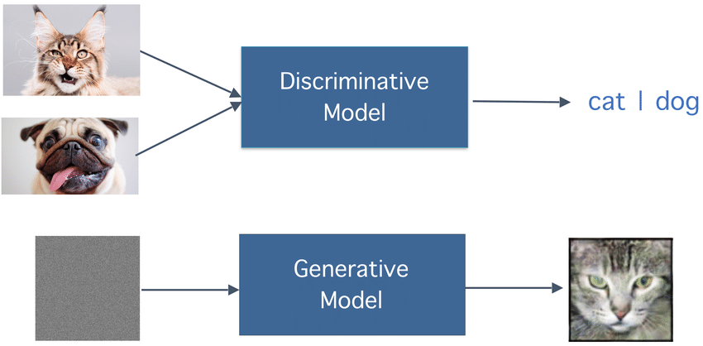
Discriminative vs Generative Model

Slide 8
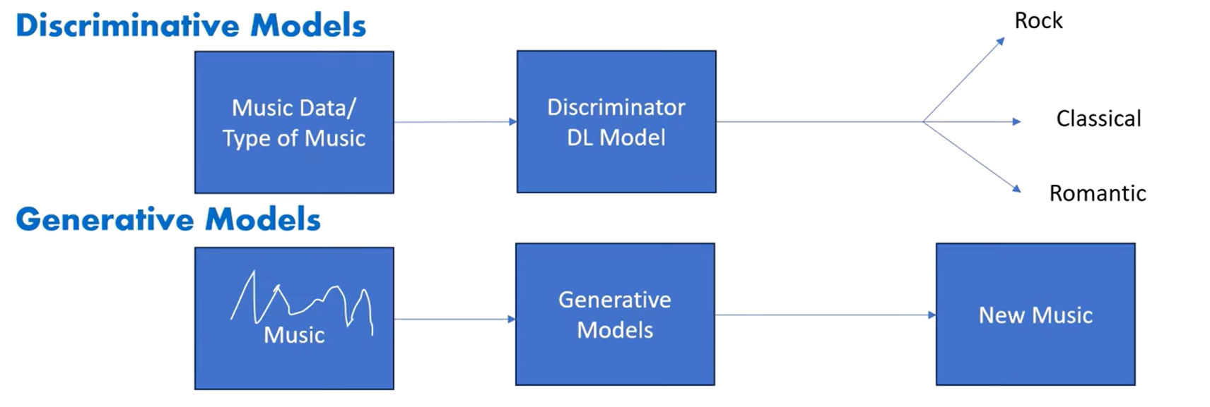
Discriminative vs Generative Model

Slide 9
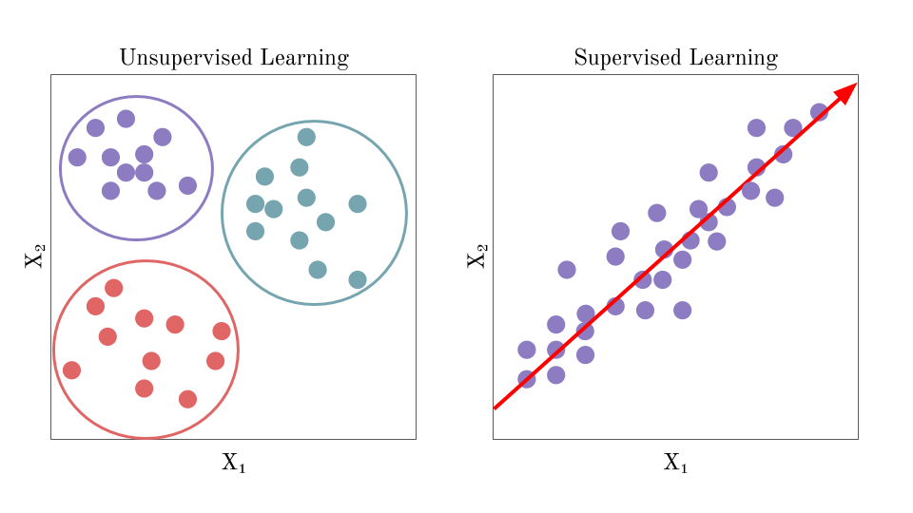
Clustering:
K-Means
DBScan
Classification & Regression:

Slide 10
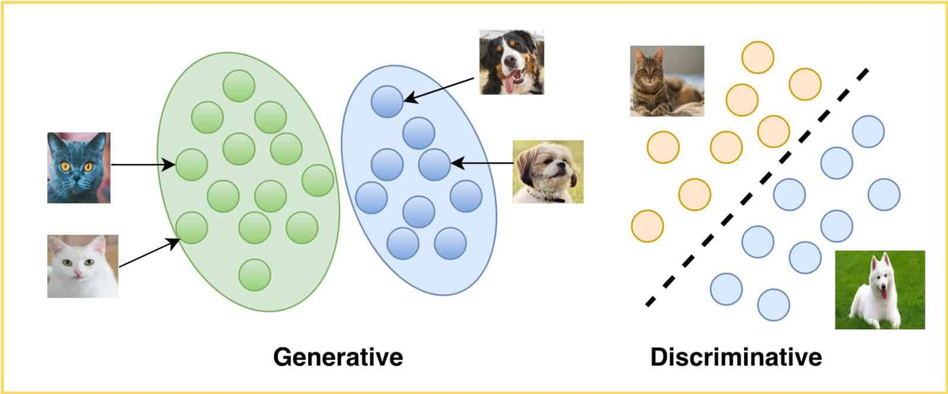
Generative AI is a subset of deep learning and Generative models are trained on huge amount of data. While training the generative model we don’t need to provide a label data, It is not possible when we have a huge amount of data, So, it's just try to see the relationship between the distribution of the data. In Generative AI we give unstructured data to the LLM model for training purpose.

Slide 11
What is LLMs?
Large Language Models (LLMs) are foundational machine learning models that use deep learning algorithms to process and understand natural language. These models are trained on massive amounts of text data to learn patterns and entity relationships in the language.
It is a language model which is responsible for performing task such as text to text generation , text to image generation and image to text generations.

Slide 12
What makes LLM so Powerful?
In case of LLM, one model can be used for a whole variety of tasks like:-
Text generation, Chatbot, summarizer, translation, code generation
& so on …
So, LLM is subset of Deep Learning & it has some properties merge with
Generative AI

Slide 13


Slide 14
Thank You!

Slide 15
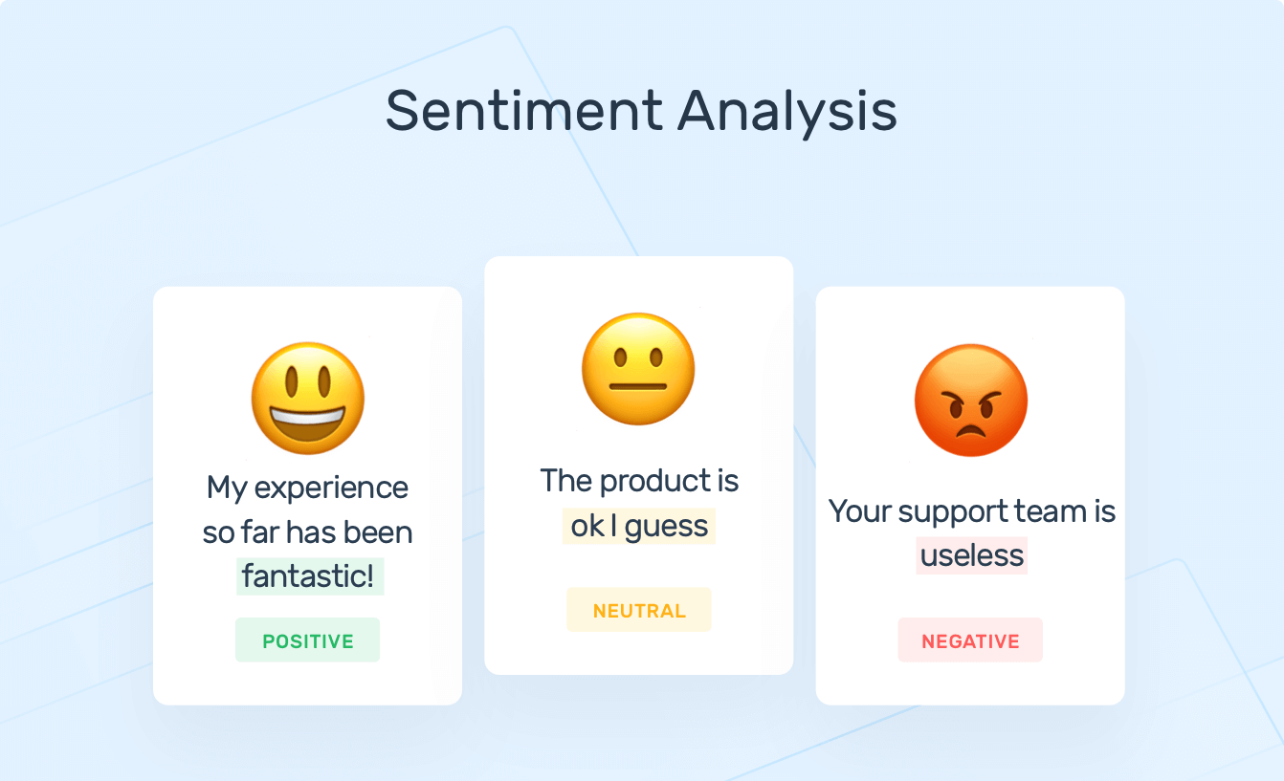

Why LLM so Powerful?
Train the model for a specific task

Slide 16
Few milestone in large language model
Bard
GPT
XLM
T5
M2M-100

